Slide 1
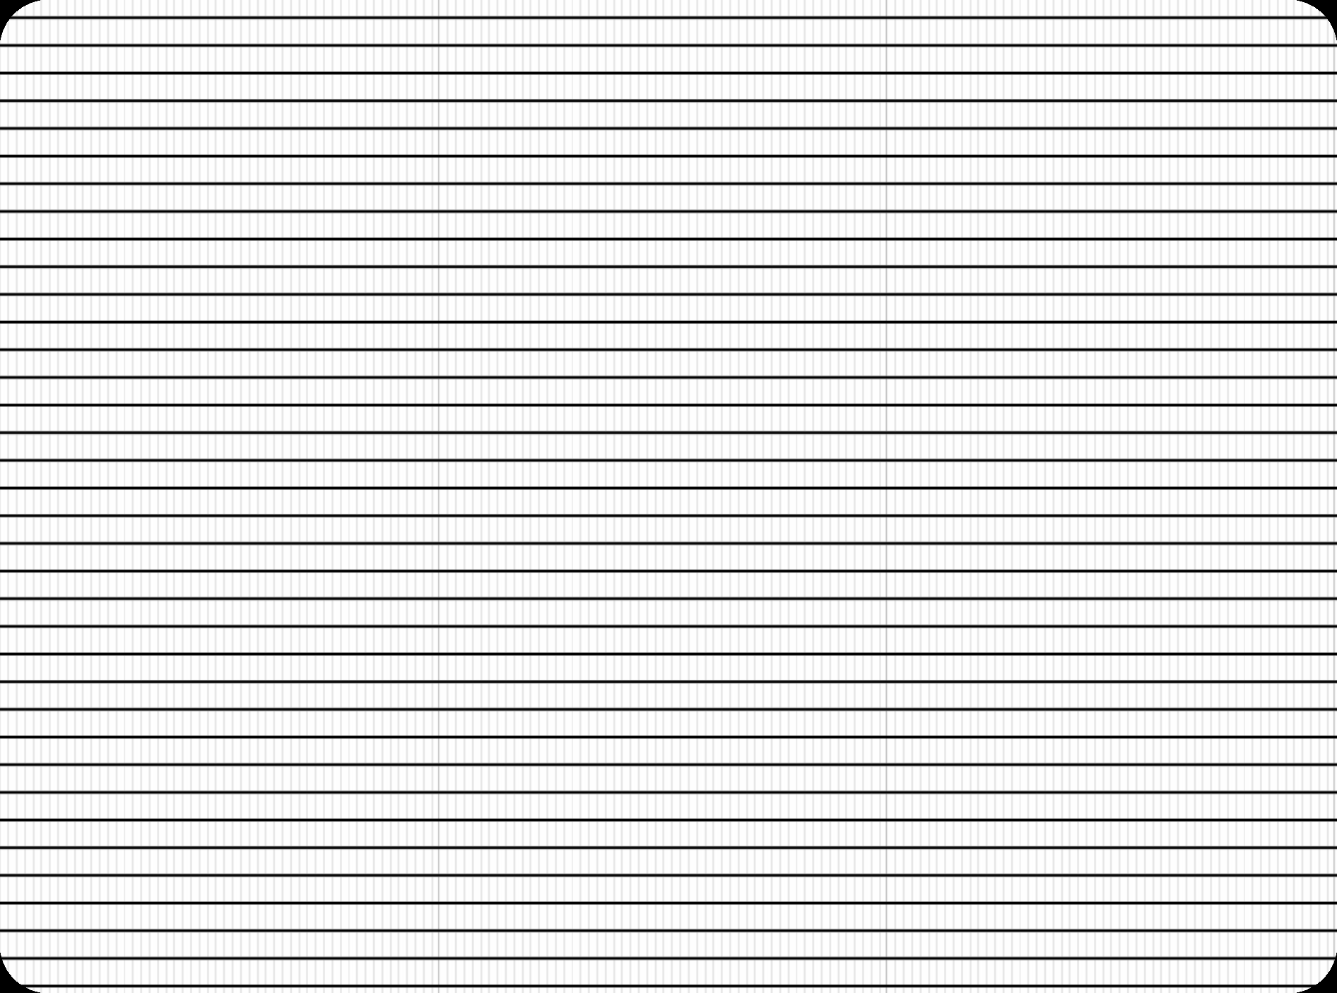

SRM
INSTITUTE OF SCIENCE AND TECHNOLOGY,
RAMAPURAM, CHENNAI.
Department of Computer Science and Engineering
18CSS101J – Programming for Problem Solving Unit II

Slide 2

SRM
INSTITUTE OF SCIENCE AND TECHNOLOGY,
CHENNAI.
UNIT II
Relational and logical Operators - Condition Operators, Operator Precedence - Expressions with pre / post increment Operator - Expression with conditional and assignment operators - If statement in expression - L value and R value in expression - Control Statements – if and else - else if and nested if, switch case - Iterations, Conditional and Unconditional Branching - For loop - While loop - do while, goto, break, continue – Array - Initialization and Declaration-- Initialization: one Dimensional Array-Accessing, Indexing one Dimensional Array Operations - Array Programs – 1Dnitializing and accessing of 2D Array – Initializing multidimensional Array – Array programs 2D – Array contiguous memory – Array
advantages and Limitations – Array construction for real-time application common programming errors

Slide 3
SRM
INSTITUTE OF SCIENCE AND TECHNOLOGY,
CHENNAI.
2. 1 Operators in C
Relational Operators
Logical Operators
Conditional Operators

Slide 4
SRM
INSTITUTE OF SCIENCE AND TECHNOLOGY,
CHENNAI.
2. 1 Operators in C Contd…
Relational Operators
  Binary Operators (or) Boolean Operators
  Produces an integer result
    Condition True : Integer value is 1
    Condition False : Integer value is 0
  Compares
    Values between two variables
    Values between variables and constants

Slide 5
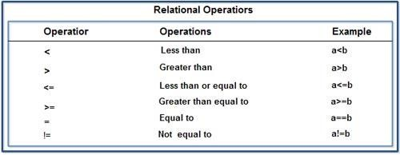
SRM
INSTITUTE OF SCIENCE AND TECHNOLOGY,
CHENNAI.
2. 1 Operators in C Contd…
Relational Operators Contd…
  Relational Expression / Boolean Expression : An expression containing a relational operator

Slide 6
SRM
INSTITUTE OF SCIENCE AND TECHNOLOGY,
CHENNAI.
2. 1 Operators in C Contd…
Relational Operators Contd…
  Consider a = 10 and b =4. The relational expression returns the following integer values
Relational Expression | Result | Return Values
a < b | False | 0
a > b | True | 1
a < = b | False | 0
a > = b | True | 1
a = = b | False | 0
a ! = b | True | 1

Slide 7
/* Program for Relational Operations*/
#include<stdio.h>
int main( )
{
int a,b;
printf("Enter the two Values\n");
scanf("%d%d", &a, &b);
printf(“a>b is %d\n“, (a>b));
printf(“a<b is %d\n“, (a<b));
printf(“a>=b is %d\n“, (a>=b)); printf(“a<=b is %d\n“, (a<=b)); printf(“a==b is %d\n“, (a==b)); printf(“a!=b is %d\n“, (a!=b)); return 0;
}

Slide 8
Output
4
2
a > b is 1 a < b is 0
a > = b is 1 a < = b is 0 a = = b is 0 a ! = b is 1

Slide 9
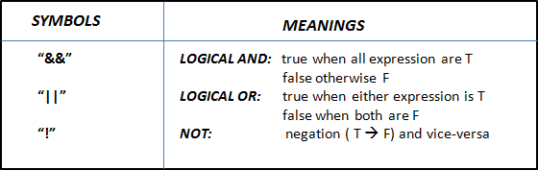
SRM
INSTITUTE OF SCIENCE AND TECHNOLOGY,
CHENNAI.
2. 1 Operators in C Contd…
Logical Operators
  Combines two or more relations
  Used for testing one or more conditions

Slide 10
SRM
INSTITUTE OF SCIENCE AND TECHNOLOGY,
CHENNAI.
2. 1 Operators in C Contd…
Logical Operators Contd…
  Logical Expression / Compound Relational Expression : An expression which combines two or more relational expression
Op1 | Op2 | Op1 && Op2 | Op1 || Op2
F (0) | F (0) | F (0) | F (0)
F (0) | T (1) | F (0) | T (1)
T (1) | F (0) | F (0) | T (1)
T (1) | T (1) | T (1) | T (1)

Slide 11
SRM
INSTITUTE OF SCIENCE AND TECHNOLOGY,
CHENNAI.
2. 1 Operators in C Contd…
Logical Operators Contd…
  Consider a = 10 and b =4. The Logical expression returns the following integer values
Relational Expression | Result | Return Values
a < 5 && b > 2 | True | 1
a < 5 && b < 2 | False | 0
a >5 && b < 2 | False | 0
a >5 || b < 2 | True | 1
a <5 || b < 2 | False | 0
a > 5 || b < 2 | True | 1

Slide 12
/* Program for Logical Operations*/
#include<stdio.h>
int main( )
{
int age,height;
printf("Enter Age of Candidate:\n"); scanf("%d", &age);
printf(“Enter Height of Candidate:\n“);
scanf("%d", &height);
if ((age>=18) && (height>=5))
printf(“The Candidate is Selected”); else
printf(“Sorry, Candidate not Selected”);
return 0;
}

Slide 13
Output 1
Enter Age of Candidate: 18 Enter Height of Candidate: 6 The Candidate is Selected
Output 2
Enter Age of Candidate: 19 Enter Height of Candidate: 4
Sorry, Candidate not Selected

Slide 14
SRM
INSTITUTE OF SCIENCE AND TECHNOLOGY,
CHENNAI.
2. 1 Operators in C Contd…
Conditional Operators
  ? and are the Conditional Operators
  Also called as Ternary Operators
  Shorter form of if-then-else statement
  Syntax
Expression 1 ? Expression 2 : expression 3
If expression 1 is true then the value returned will be expression 2
Otherwise the value returned will be expression 3

Slide 15
SRM
INSTITUTE OF SCIENCE AND TECHNOLOGY,
CHENNAI.
#include<stdio.h> int main( )
{
int x, y;
scanf("%d", &x); if(x >5)
y=3;
else
y=4;
printf(“%d”, y);
return 0;
}
#include<stdio.h> int main( )
{
int x, y;
scanf("%d", &x);
y=(x > 5 ? 3 : 4);
printf(“%d”, y); return 0;
}

Slide 16
/* Program for Addition (or) Multiplication*/
#include<stdio.h>
int main( )
{
int a, b, result, choice;
printf(“Enter first number \n”); scanf(“%d”,&a);
printf(”Enter second number\n”);
scanf(“%d”,&b);
printf(“Enter 1 for addition or 2 for multiplication\n”); scanf(“%d”,&choice);
result = (choice==1)?a+b:(choice==2)?a*b:printf(“Invalid”); if(choice==1||choice==2)
printf(“The result is %d\n\n”,result); return 0;
}

Slide 17
Output
Enter first number 10
Enter second number
3
Enter 1 for addition or 2 for multiplication 2
The result is 30

Slide 18
/* Program to find the maximum of 3 Numbers*/
#include <stdio.h> int main( )
{
int a, b, c, max;
printf("Enter three numbers: ");
scanf("%d%d%d",&a, &b, &c);
max = (a > b && a > c) ? a : (b > c) ? b : c;
printf("\n Maximum between %d, %d and %d = %d", a, b, c, max);
return 0;
}

Slide 19
Output
Enter three numbers: 30 10 40 Maximum between a, b and c = 40

Slide 20
SRM
INSTITUTE OF SCIENCE AND TECHNOLOGY,
CHENNAI.
2. 2 Operator Precedence
Operator Precedence is used to determine the order of
operators evaluated in an expression
  Every operator has precedence (Priority)
  Operator with higher precedence is evaluated first and the operator with least precedence is evaluated last
Associativity is used when two operators of same precedence appear in an expression
  Determines the order of evaluation of those operators
  Associativity can be either Left to Right or Right to Left

Slide 21
SRM
INSTITUTE OF SCIENCE AND TECHNOLOGY,
CHENNAI.
2. 2 Operator Precedence Contd…
Operators are listed in descending order of precedence
An Expression can contain several operators with equal precedence
  Evaluation proceeds according to the associativity of the operator i.e.,
    From Right to Left (or)
    From Left to Right
Note: Order of operations is not defined by the language

Slide 22
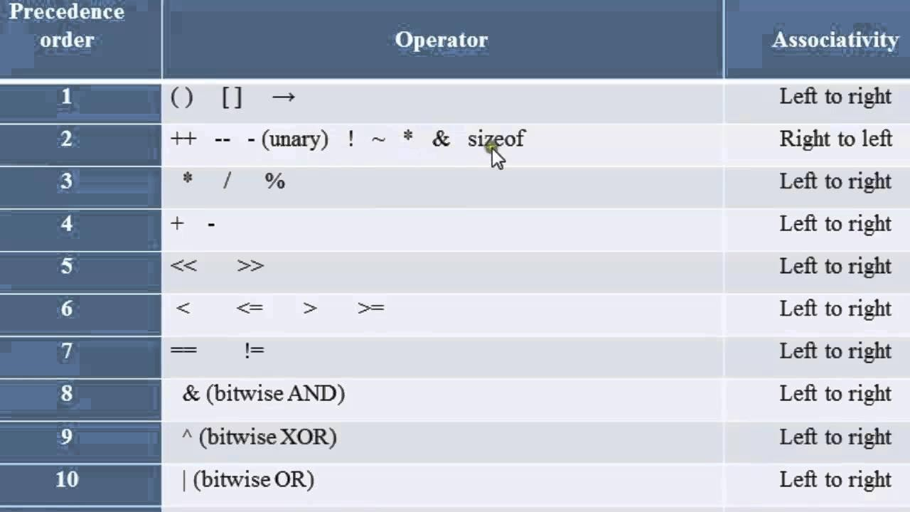
SRM
INSTITUTE OF SCIENCE AND TECHNOLOGY,
CHENNAI.

Slide 23
SRM
INSTITUTE OF SCIENCE AND TECHNOLOGY,
CHENNAI.
2. 3 Expressions using Pre/Post Increment Operator
Increment operators increase the value of the variable by one
Decrement operators decrease the value of the variable by one
Syntax
Increment operator: ++var_name; (or) var_name++; Decrement operator: – -var_name; (or) var_name – -;
Example
Increment operator : ++ i ;i ++ ; Decrement operator :– – i ;i – – ;

Slide 24
/* Expresssions using Pre-Increment Operator*/
#include<stdio.h> int main( )
{
int x,i;
i=10;
x=++i;
printf("x: %d",x);
printf("i: %d",i); return 0;
}
Output
x: 11
i: 11

Slide 25
/* Expresssions using Post-Increment Operator*/
#include<stdio.h> int main( )
{
int x,i;
i=10;
x=i++;
printf("x: %d",x);
printf("i: %d",i); return 0;
}
Output
x: 10
i: 11

Slide 26
/* Expresssions using Pre-Decrement Operator*/
#include<stdio.h> int main( )
{
int x,i;
i=10;
x=--i;
printf("x: %d",x);
printf("i: %d",i); return 0;
}
Output
x: 9
i: 9

Slide 27
/* Expresssions using Post-Decrement Operator*/
#include<stdio.h> int main( )
{
int x,i;
i=10;
x=i--;
printf("x: %d",x);
printf("i: %d",i); return 0;
}
Output
x: 10
i: 9

Slide 28
/* Expresssions using Increment / Decrement Operators*/
#include<stdio.h> int main( )
{
int p,q,x,y;
printf(“Enter the value of x \n”);
scanf(“%d” ,&x);
printf(“Enter the value of y \n”); scanf(“%d” ,&y);
printf(“x=%d\ny=%d\n”,x,y);
p=x++;
q=y++;
printf(“x=%d\ty=%d\n”,x,y); printf(“x=%d\tq=%d\n”,p,q); p=--x;
q=--y;
printf(“x=%d\ty=%d\n”,x,y); printf(“p=%d\tq=%d\n”,p,q); return 0;
}

Slide 29
Output
Enter the value of x 10 Enter the value of y 20 x = 10
y = 20
x = 11
p = 10
x = 10
p = 10
y = 21
q = 20
y = 20
q = 20

Slide 30

SRM
INSTITUTE OF SCIENCE AND TECHNOLOGY,
CHENNAI.
2. 4 Expressions using Conditional Operator
Any operator is used on three operands or variable is known
as Ternary Operator
It can be represented with ? : . It is also called as conditional operator

Slide 31
/* Program for Printing Odd or Even Number*/
#include<stdio.h> int main( )
{
int num;
printf("Enter the Number : ");
scanf("%d",&num); (num%2==0)?printf("Even\n"):printf("Odd");
}
Output
Enter the Number : 10 Even

Slide 32
/* Program for Eligibility to Vote*/
#include<stdio.h> int main( )
{
int age;
printf(" Please Enter your age here: \n "); scanf(" %d ", &age);
(age >= 18) ? printf(" You are eligible to Vote ") : printf(" You are not
eligible to Vote ");
return 0;
}
Output
Please Enter your age here: 19 You are eligible to Vote

Slide 33
/* Program for Finding Biggest of 2 Numbers*/
#include<stdio.h> int main( )
{
int a, b, max; printf("Enter a and b: "); scanf("%d%d", &a, &b);
max = a > b ? a : b; printf("Largest of the two numbers = %d\n", max);
return 0;
}
Output
Enter a and b: 10 20
Largest of the two numbers = 20

Slide 34
SRM
INSTITUTE OF SCIENCE AND TECHNOLOGY,
CHENNAI.
2. 5 Expressions using Assignment Operator
Assignment Operator is used to assign value to an variable
Assignment Operator is denoted by equal to sign
Assignment Operator is binary operator which operates on two operands
Assignment Operator have Two Values – L-Value and R-Value
  Operator = copies R-Value into L-Value
Assignment Operator have lower precedence than all available operators but has higher precedence than comma Operator

Slide 35
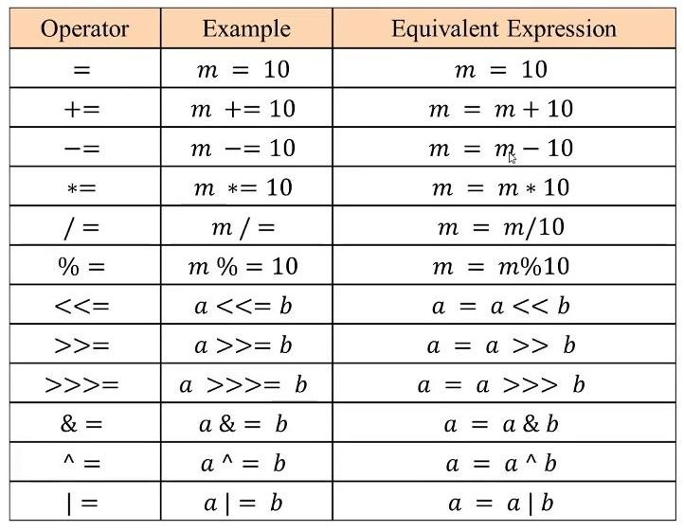

Slide 36
SRM
INSTITUTE OF SCIENCE AND TECHNOLOGY,
CHENNAI.
2. 6 L-Value and R-Value of Expression
L-Value stands for left value
  L-Value of Expressions refer to a memory locations
  In any assignment statement L-Value of Expression must be a container(i.e. must have ability to hold the data)
  Variable is the only container in C programming thus L Value must be any Variable.
  L Value cannot be a Constant, Function or any of the available data type in C

Slide 37
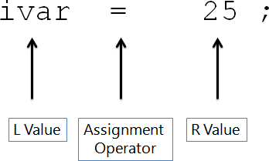
SRM
INSTITUTE OF SCIENCE AND TECHNOLOGY,
CHENNAI.
2. 6 L-Value and R-Value of Expression Contd…
Diagram Showing L-Value of Expression :

Slide 38
SRM
INSTITUTE OF SCIENCE AND TECHNOLOGY,
CHENNAI.
2. 6 L-Value and R-Value of Expression Contd…
#include<stdio.h>
int main( )
{
int num;
num = 5;
return(0);
}
#include<stdio.h>
int main( )
{
int num;
5 = num; //Error
return(0);
}
#include<stdio.h>
int main( )
{
const num;
num = 20; //Error
return(0);
}
Example of L- Value Expression
L-value cannot be a Constant
L-value cannot be a Constant Variable

Slide 39
SRM
INSTITUTE OF SCIENCE AND TECHNOLOGY,
CHENNAI.
2. 6 L-Value and R-Value of Expression Contd…
#include<stdio.h>
#define MAX 20
int main( )
{
MAX = 20; //Error
return(0);
}
#include<stdio.h>
enum {JAN,FEB,MARCH};
int main( )
{
JAN = 20; //Error
return(0);
}
L-value cannot be a MACRO
L-value cannot be a Enum Constant

Slide 40
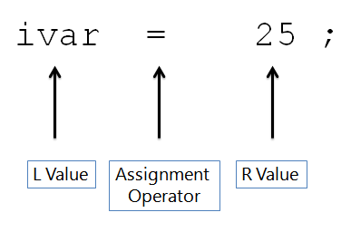
SRM
INSTITUTE OF SCIENCE AND TECHNOLOGY,
CHENNAI.
2. 6 L-Value and R-Value of Expression Contd…
R Value stands for Right value of the expression
  In any Assignment statement R-Value of Expression must be anything which is capable of returning Constant Expression or Constant Value

Slide 41
SRM
INSTITUTE OF SCIENCE AND TECHNOLOGY,
CHENNAI.
2. 6 L-Value and R-Value of Expression Contd…
Examples of R-Value of Expression
Variable | Constant
Function | Macro
Enum Constant | Any other data type
R value may be a Constant or Constant Expression
R value may be a MACRO
R Value may be a variable

Slide 42
SRM
INSTITUTE OF SCIENCE AND TECHNOLOGY,
CHENNAI.
7 Control Statements
  Also called as Conditional Statement
  Decides order of execution based on conditions
  Helps repeat a group of statements
  Modifies control flow of program
  Decision Making
  Branching

Slide 43
SRM
INSTITUTE OF SCIENCE AND TECHNOLOGY,
CHENNAI.
2. 7 Control Statements Contd...
Types of Branching Statements
  if statement
    Simple if
    if…else statement
    nested if…else statement
    else…if statement
  switch statement
  goto statement

Slide 44
SRM
INSTITUTE OF SCIENCE AND TECHNOLOGY,
CHENNAI.
2. 7 Control Statements Contd...
if statement
  Condition “True" - Statement block will be executed
  Condition “False“ - Statement block will not be executed.
  Variations
    Simple if
    if…else statement
    nested if…else statement
    else…if statement

Slide 45
SRM
INSTITUTE OF SCIENCE AND TECHNOLOGY,
CHENNAI.
2. 7 Control Statements Contd...
Simple if statement
  Basic if statement
  What is a condition?
  Executes statement block only if condition is true
  Syntax
if (condition)
{
Statements;
}

Slide 46
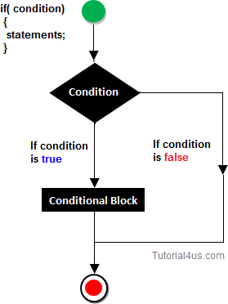

Slide 47
/* Simple if – Program to check whether a number is Odd*/ #include<stdio.h>
int main( )
{
int number;
printf(“Enter the Number: ”); scanf(“%d, &number); if(number%2==0)
{
printf(“The Number is Even”);
}
return 0;
}
Output
Enter a value : 10342 The number is Even

Slide 48
SRM
INSTITUTE OF SCIENCE AND TECHNOLOGY,
CHENNAI.
2. 7 Control Statements Contd...
Try it Out Yourself ! Write a C program to:
  Check whether the given number is Even
  To check whether the given number is Greater
  To check whether the given number is Smaller
  To check whether the given number is positive
  To check whether the given number is negative
  To check whether the given number is zero
  To check whether two numbers are equal

Slide 49
SRM
INSTITUTE OF SCIENCE AND TECHNOLOGY,
CHENNAI.
2. 7 Control Statements Contd...
If else statement
  Extension of basic if statement
  Takes care of True and False condition
  Number of Statement Blocks - 2
    Block 1 – True Condition
    Block 2 – False Condition

Slide 50
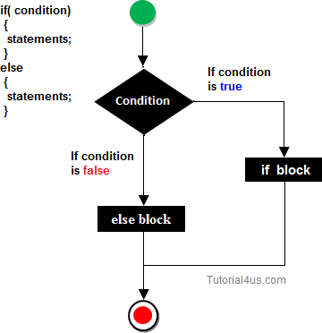
if (condition)
{
Statements;
}
Else
{
Statements;
}

Slide 51
/* if else –To check whether a number is Odd or Even*/
#include<stdio.h> int main( )
{
int number;
printf(“Enter the Number: ”); scanf(“%d, &number); if(number%2==0)
{
printf(“The Number is Even”);
}
else
{
printf(“The Number is Odd”);
}
return 0;
}

Slide 52
Output 1
Enter the Number : 10341
The number is Odd
Output 2
Enter the Number : 10342 The number is Even

Slide 53
SRM
INSTITUTE OF SCIENCE AND TECHNOLOGY,
CHENNAI.
2. 7 Control Statements Contd...
Try it Out Yourself ! Write a C program to:
  To check whether the given number is Greater or Smaller
  To check whether the given number is +ve or -ve
  To check whether two numbers are equal or not

Slide 54
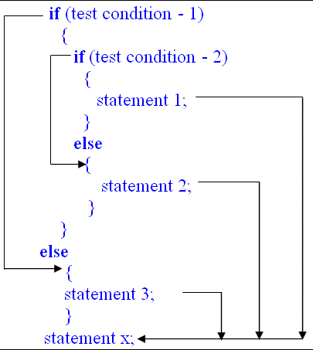
SRM
INSTITUTE OF SCIENCE AND TECHNOLOGY,
CHENNAI.
2. 7 Control Statements Contd...
iii. Nested if else statement
Used when a series of decisions are involved
Makes a choice between several alternatives
New if else statement block is used within existing if else statement block

Slide 55
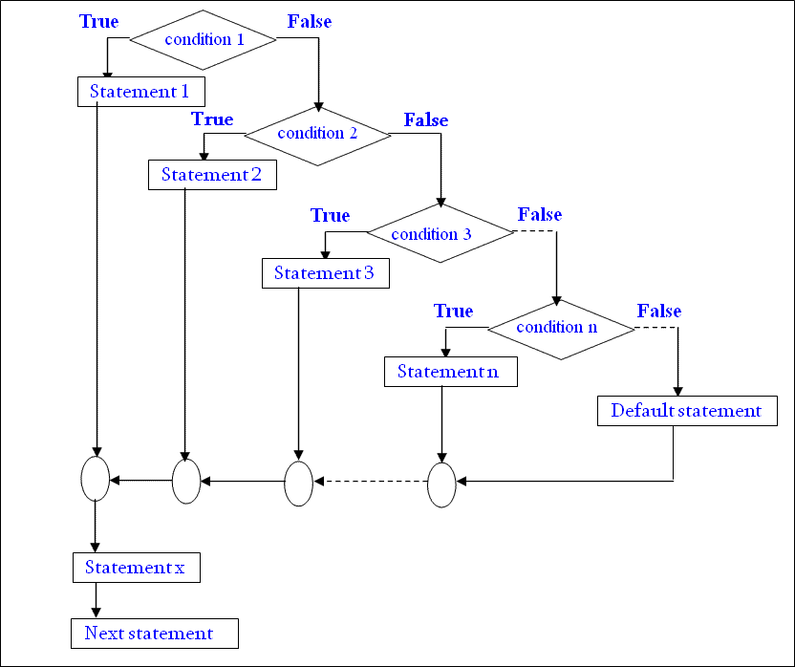

Slide 56
/*Program for Nested if else */
#include <stdio.h>
void main( )
{
char username;
int password; printf("Username:"); scanf("%c",&username); printf("Password:"); scanf("%d",&password);

Slide 57
if(username=='a')
{
if(password==12345)
{
printf("Login successful");
}
else
{
printf("Password is incorrect, Try again.");
}
}
else
{
printf("Username is incorrect, Try again.");
}
return 0;
}

Slide 58
Output 1 Username: a Password: 12345 Login Successful
Output 2 Username: a Password: 54321
Password is incorrect, Try again.
Output 3 Username: b Password: 54321
Username is incorrect, Try again.

Slide 59
SRM
INSTITUTE OF SCIENCE AND TECHNOLOGY,
CHENNAI.
2. 7 Control Statements Contd...
Step 1: First if condition will be true, if the user has typed 'a' as a username then the program control moves to second if condition and checks for the password
  if it true it will print 'login successful’
  else it will execute block statement 'Password is Incorrect, Try again.‘.
Step 2: If the first if condition is false then it executes last else block thus printing 'Username is Incorrect, Try again.‘

Slide 60
SRM
INSTITUTE OF SCIENCE AND TECHNOLOGY,
CHENNAI.
2. 7 Control Statements Contd...
Step 3: In this above example we have use username as single character to use multiple character username we need to use string data type

Slide 61
SRM
INSTITUTE OF SCIENCE AND TECHNOLOGY,
CHENNAI.
2. 7 Control Statements Contd...
Switch statement
  Allows to make decisions from a number of choices
  Also called as Switch-Case-Default Statement
  Faster than nested if else statement
  Easier to understand
  Rules for writing switch ( ) statement
    Expression in switch must be an integer value or a character constant
    No real numbers used in Expression

Slide 62
SRM
INSTITUTE OF SCIENCE AND TECHNOLOGY,
CHENNAI.
7 Control Statements Contd...
  Each case block and default block must end with break
statements
  Default is optional
  Case keyword must end with colon ( : )
  Default may be placed anywhere in the switch
  No two case constants are identical

Slide 63
SRM
INSTITUTE OF SCIENCE AND TECHNOLOGY,
CHENNAI.
2. 7 Control Statements Contd...
switch(variable or expression)
{
case constant 1:
statements;
break;
….
case constant N;
statements;
break; default:
statements;
}

Slide 64
/* Program for Switch Case*/
#include<stdio.h> int main( )
{
int a, b, choice;
printf(“\nEnter Two Numbers: ”); scanf(“%d%d”, &a,&b);
printf(“\n Enter 1 for Addition”); printf(“\n Enter 2 for Subtraction”);
printf(“\n Enter 3 for Multiplication”);
printf(“\n Enter 4 for Division”); printf(“ Enter your Choice”); scanf(“%d”,&choice);

Slide 65
switch (choice)
{
case 1:
printf(“Sum is : %d”, a+b); break;
case 2:
printf(“Difference is : %d”, a-b); break;
case 3:
printf(“Multiplication is : %d”, a*b); break;
case 4:
printf(“Difference is : %d”, a/b); break;

Slide 66
default:
printf(“Invalid Choice:”);
}
getch( );
}
Enter two numbers
20
10
Enter 1 for Addition Enter 2 for Subtraction Enter 3 for Multiplication
Enter 4 for Division Enter your Choice: 3 Product is : 200

Slide 67
SRM
INSTITUTE OF SCIENCE AND TECHNOLOGY,
CHENNAI.
2. 7 Control Statements Contd...
Nested Switch statement
  Inner switch( ) can be a part of an outer switch( )
  Inner switch( ) and outer switch( ) case constants may be the same

Slide 68
/* Program for Nested Switch Case*/
#include<stdio.h> int main( )
{
int square, i, n, fact = 1,choice; printf(“\n Enter Any Number: ”); scanf(“%d”, &n);
printf(“ 1. Square \n”); printf(“ 2. Factorial \n”);
printf(“ 3. Find Odd or Even \n”);
printf(“ 4. Exit \n”);
printf(“ Enter your Choice”); scanf(“%d”, &choice);

Slide 69
switch (choice)
{
case 1:
square = n * n;
printf(“The Square of the Given number is %d\n”,
square);
break; case 2:
for(i=1;i<=n;i++)
{
fact = fact * i;
}
printf(“The Factorial of a given number is %d\n”, fact);
break;

Slide 70
switch (n%2)
{
case 0:
printf(“Given Number is Even\n”); case 1:
printf(“Given Number is Odd\n”);
}
case 3:
exit(0);
default:
printf(“Invalid Choice. Please try again\n”);
}
return 0;
}

Slide 71
Enter any number
5
Square
Factorial
Find Odd or Even
Exit
Enter your choice 2
The factorial of a given number is: 120

Slide 72
SRM
INSTITUTE OF SCIENCE AND TECHNOLOGY,
CHENNAI.
2. 7 Control Statements Contd...
The goto statement
  Transfers control from one point to another
  Syntax
goto label;
statements;
……………
label
statements;

Slide 73
SRM
INSTITUTE OF SCIENCE AND TECHNOLOGY,
CHENNAI.
2. 8 Looping Statements
Loop – A segment of the program that is executed repeatedly
until a condition is satisfied
Classification – Entry Controlled & Exit Controlled
Types
  while do loop
  do while loop
  for loop
    Nested for loop

Slide 74
SRM
INSTITUTE OF SCIENCE AND TECHNOLOGY,
CHENNAI.
2. 8 Looping Statements Contd...
The While Loop
  Simplest looping structure in C
  Statements in the program may need to repeat for many times. e.g., calculate the value of n!
  Loop consists of two segments
    Control Statement
    Body of the Loop
  How while loop works?

Slide 75
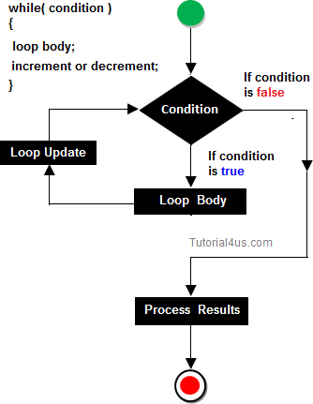
SRM
INSTITUTE OF SCIENCE AND TECHNOLOGY,
CHENNAI.
Initialize loop counter variable;
while (condition)
{
Statements;
increment / Decrement loop
counter variable;
}

Slide 76
/* Program to Add 3 Numbers*/
#include<stdio.h> int main( )
{
int a, b, c, sum;
printf(“\n Enter the Three Numbers: ”); scanf(“%d%d%d”, &a,&b,&c);
sum = a+b+c;
printf(“The sum of 3 Numbers is %d”, sum); return 0;
}
Output
Enter the Three Numbers: 10 20 30 The sum of 3 Numbers is: 60

Slide 77
/* Program to Add n Numbers*/
#include<stdio.h> int main( )
{
int i=1,n, sum=0;
printf(“\n Enter the value for n: ”); scanf(“%d”, &n);
while (i<=n)
{
sum = sum + i; i++;
}
printf(“The sum of n Numbers is: %d”, sum); return 0;
}

Slide 78
Output
Enter the value for n: 5
The sum of n Numbers is: 15

Slide 79
SRM
INSTITUTE OF SCIENCE AND TECHNOLOGY,
CHENNAI.
2. 8 Looping Statements Contd...
Try it Out Yourself ! Write a C program to:
  To print all even numbers from 1 to 100
  To print all even numbers from 1 to n
  To print table for any number
  To calculate the sum of its digits
  To check whether the entered number is Prime or not
  To get a number as input and print it in reverse.
  To check whether the number is Armstrong number

Slide 80
SRM
INSTITUTE OF SCIENCE AND TECHNOLOGY,
CHENNAI.
2. 8 Looping Statements Contd...
The Do While Loop
  The body of the loop is executed at least once
  Syntax
do
{
statements;
}
while (condition);

Slide 81
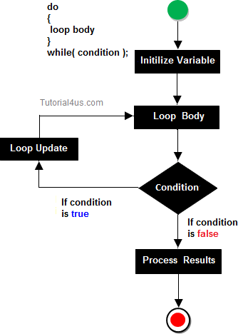
SRM
INSTITUTE OF SCIENCE AND TECHNOLOGY,
CHENNAI.
Initialize loop counter variable; do
{
Statements;
increment / Decrement loop
counter variable;
}
while (condition)

Slide 82
SRM
INSTITUTE OF SCIENCE AND TECHNOLOGY,
CHENNAI.
2. 8 Looping Statements Contd...
While Do Loop | Do While Loop
Entry Controlled Loop | Exit Controlled Loop
Test condition is checked before body of the loop is executed | Test condition is checked after the body of the loop is executed
Loop will not be executed if condition is false | Loop will be executed at least once even if condition is false
Top tested loop | Bottom tested loop

Slide 83
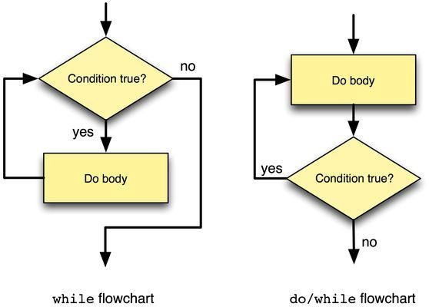
SRM
INSTITUTE OF SCIENCE AND TECHNOLOGY,
CHENNAI.
2. 8 Looping Statements Contd...

Slide 84
SRM
INSTITUTE OF SCIENCE AND TECHNOLOGY,
CHENNAI.
2. 8 Looping Statements Contd...
The for loop
  Most commonly and popularly used loop structure
  Structure of the for loop
    Initialize loop counter variable
    Check for condition
    Increment / Decrement the loop counter variable
  Syntax
for(initialization; condition; increment / decrement)

Slide 85
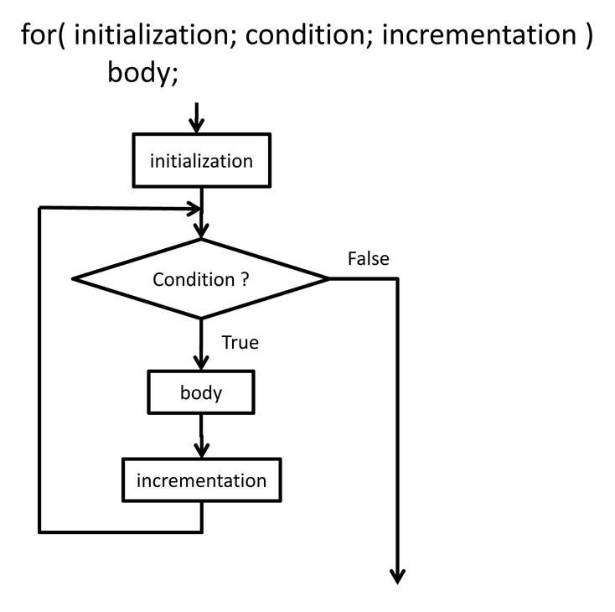
SRM
INSTITUTE OF SCIENCE AND TECHNOLOGY,
CHENNAI.
2. 8 Looping Statements Contd...

Slide 86
SRM
INSTITUTE OF SCIENCE AND TECHNOLOGY,
CHENNAI.
2. 8 Looping Statements Contd...
Examples
  for(i = 0; i < n; i++)
{
Statements;
}
  for(count = 0; count > n; count--)
{
Statements;
}

Slide 87
/* Program to Add n Numbers using for loop */
#include<stdio.h> int main( )
{
int i, n, sum=0;
printf(“\n Enter the value for n: ”); scanf(“%d”, &n);
for (i =1; i<=n; i++)
{
sum = sum + i;
}
printf(“The sum of n Numbers is: %d”, sum);
return 0;
}

Slide 88
Output
Enter the value for n: 5
The sum of n Numbers is: 15

Slide 89
SRM
INSTITUTE OF SCIENCE AND TECHNOLOGY,
CHENNAI.
2. 8 Looping Statements Contd...
Try it Out Yourself ! Write a C program to:
  To print all even numbers from 1 to 100
  To print all even numbers from 1 to n
  To print table for any number
  To calculate the sum of its digits
  To check whether the entered number is Prime or not
  To get a number as input and print it in reverse.
  To check whether the number is Armstrong number

Slide 90
SRM
INSTITUTE OF SCIENCE AND TECHNOLOGY,
CHENNAI.
2. 9 Arrays
Definition
An array is defined as finite ordered collection of homogenous data, stored in contiguous memory locations.
  Array is used to store a collection of data
  Array is a collection of variables of the same type.
First Element
Last Element
Numbers[0] | Numbers[1] | ……. | Numbers[n]

Slide 91
SRM
INSTITUTE OF SCIENCE AND TECHNOLOGY,
CHENNAI.
2. 9 Arrays Contd...
Need for Arrays
  Used to represent a list of numbers / names
  Used to represent tabular data in 2, 3 or more dimensions
  Important Data Structure in any programming language
Definition
  Collection of elements of similar data types
  Each element is located in separate memory locations
  Each Array element share a common name

Slide 92
SRM
INSTITUTE OF SCIENCE AND TECHNOLOGY,
CHENNAI.
2. 9 Arrays Contd...
Characteristics of Arrays
  All elements in the arrays share a common name
  Elements distinguished by index number
  Index (or) element number of an array plays vital role for calling each element
  Specific array elements can be modified
  Value of array element can be assigned to variables
  Array elements stored in continuous memory locations

Slide 93
SRM
INSTITUTE OF SCIENCE AND TECHNOLOGY,
CHENNAI.
2. 9 Arrays Contd...
Storage space for array depends on its data type and size
Total bytes = sizeof (Data type) x Size of Array
  Example
int a [5];
Total bytes = sizeof (int) x 5 = 2 x 5 = 10 bytes

Slide 94
SRM
INSTITUTE OF SCIENCE AND TECHNOLOGY,
CHENNAI.
2. 9 Arrays Contd...
Array Declaration
  Syntax
Datatype arrayname [size/subscript];
  Data Type: int, float, double, char, structure, union
  Array Name: Name given to the Array variable
  Size / Subscript: Number of values an Array can hold
  Examples
int numbers[5]; char name[20];
float marks[50]; double a[i];

Slide 95
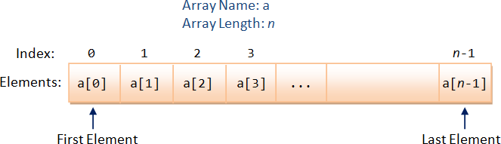
SRM
INSTITUTE OF SCIENCE AND TECHNOLOGY,
CHENNAI.
2. 9 Arrays Contd...
Illustration
int a[n];

Slide 96
SRM
INSTITUTE OF SCIENCE AND TECHNOLOGY,
CHENNAI.
2. 9 Arrays Contd...
Static Array: Array size (range) declared in the program
Dynamic Array: Array size given during execution
STATIC ARRAYS | DYNAMIC ARRAYS
Range / Size of an array included in the Array definition | Range / Size of an array not included in the Array definition
Static Arrays cannot be changed | Dynamic Arrays can be changed

Slide 97
SRM
INSTITUTE OF SCIENCE AND TECHNOLOGY,
CHENNAI.
2. 9 Arrays Contd...
Array Initialization
  Initialization: Assigning values to array elements
    Values specified in curly braces separated by commas
  Examples
int a[ 5] = {1, 2, 3, 4, 5};
float b[3] = { 40.5, 59.0, 98.5};
char name[6] = ” SRMIST”;
  Array element index start from 0

Slide 98
SRM
INSTITUTE OF SCIENCE AND TECHNOLOGY,
CHENNAI.
9 Arrays Contd...
  Array elements are called by array names followed by the
element numbers
  int a[ 5] = {1, 2, 3, 4, 5};
a[0] refers to 1st element i.e., 1 a[1] refers to 2nd element i.e., 2 a[2] refers to 3rd element i.e., 3 a[3] refers to 4th element i.e., 4 a[4] refers to 5th element i.e., 5

Slide 99
SRM
INSTITUTE OF SCIENCE AND TECHNOLOGY,
CHENNAI.
2. 9 Arrays Contd...
Getting Input for Arrays
  Use for loops to get input in arrays
  Use for loops with regard to the Array’s dimension
    Input for One Dimensional Arrays – 1 for loop for(i = 0; i < 5; i++)
{
scanf(“%d”, &a[i]);
}

Slide 100
SRM
INSTITUTE OF SCIENCE AND TECHNOLOGY,
CHENNAI.
2. 9 Arrays Contd...
Input for Two Dimensional Arrays – 2 for loops
for(i=0;i<5;i++)
{
for(j=0;j<5;j++)
{
scanf(“%d”,&a[i][j]);
}
}

Slide 101
SRM
INSTITUTE OF SCIENCE AND TECHNOLOGY,
CHENNAI.
2. 9 Arrays Contd...
Printing Output in Arrays
  Use for loops to print array output
  Use for loops with regard to the Array’s dimension
    Printing One Dimensional Array Output – 1 for loop for(i=0;i<5;i++)
{
printf(“%d”,a[i]);
}

Slide 102
SRM
INSTITUTE OF SCIENCE AND TECHNOLOGY,
CHENNAI.
2. 9 Arrays Contd...
Printing Two Dimensional Array Output – 2 for loops
for(i = 0; i < 5; i++)
{
for(j=0; j < 5; j++)
{
printff(“%d”, a[i][j]);
}
}

Slide 103
/* Program 1 : Array Declaration & Initialization*/
#include<stdio.h> int main( )
{
int i, arr[5];
arr[0] = 10;
arr[1] = 20;
arr[2] = 30;
arr[3] = 40;
arr[4] = 50; for(i=0; i<=n; i++)
{
printf(“%d”\n, a[i]);
}
return 0;
}

Slide 104
Output
10
20
30
40
50

Slide 105
/* Program 2 : Array Declaration & Initialization*/
#include<stdio.h> int main( )
{
int i, arr[5];
arr[5] = {10, 20, 30, 40, 50};
for(i=0; i<=n; i++)
{
printf(“%d”, a[i]);
}
return 0;
}

Slide 106
Output
10
20
30
40
50

Slide 107
/* Program 3 : Array Declaration & Initialization*/
#include<stdio.h> int main( )
{
int i, n, arr[5];
scanf(“%d”, &n);
printf(“Enter the Elements of Array\n”);
for(i=0; i<n; i++)
{
scanf(“%d”, &a[i]);
}
printf(“The Elements of the Array are”\n”);

Slide 108
for(i=0; i<n; i++)
{
printf(“%d”, a[i]);
}
return 0;
}
Output
Enter the Elements of the Array 10 20 30 40 50
The Elements of the Array are 10 20 30 40 50

Slide 109
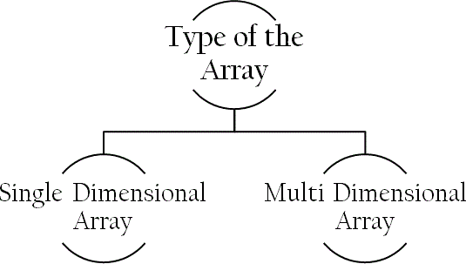
SRM
INSTITUTE OF SCIENCE AND TECHNOLOGY,
CHENNAI.
2. 9 Arrays Contd...
Classification of Arrays
  One-Dimensional Array
  Two-Dimensional Array
  Multi-Dimensional Array

Slide 110
SRM
INSTITUTE OF SCIENCE AND TECHNOLOGY,
CHENNAI.
2. 9 Arrays Contd...
One Dimensional Array
  Data stored under a single variable using one subscript
  1-D Array Declaration – Syntax
datatype arrayname [size/subscript];
    Example: int a [5];
  1-D Array initialization – Syntax
datatype arrayname [size] = { list of values};
Example: int a [5] = { 10, 20, 30, 40, 50};

Slide 111
/* Program 1 : One Dimensional Array*/
a [10]
#include<stdio.h> int main ( )
{
int a[10], n, i, sum; clrscr( );
printf(“Enter the Number of Elements\n”); scanf(“%d”, &n);
for(i = 0; i < n; i++)
{
scanf(“%d”, & a [i]);
}
sum = 0;
for(i = 0; i < n; i++)
a [0]
a [1]
a [2]
a [3]
a [4]
a [5]
a [6]
a [7]
a [8]
a [9]
n
40
22
34
12
64
i
5
0
sum
0

Slide 112
a [10]
/* Program 1 : One Dimensional Array*/
{
a [0]
a [1]
a [2]
a [3]
a [4]
a [5]
a [6]
a [7]
a [8]
a [9]
n
sum = sum + a[i];
40
22
34
12
64
}
printf(“The Sum is: %d”, sum); return 0;
}
Output
Enter the Number of Elements 5
40 22 34 12 64
The Sum is 182
i
5
4
sum
182

Slide 113
/* Program 2 : 1-D Array for Sorting*/
#include<stdio.h> int main( )
{
int i, j, temp, n, a[10];
printf(“Enter the Number of Elements:”); scanf(“%d”, &n);
printf(“Enter the Elements to be Sorted\n”);
for(i=0; i<n; i++)
{
scanf(“%d\n”, &a[i]);
}
for(i=0; i<n; i++)
{
for(j=i+1; j<n; j++)
{

Slide 114
if(a[i] >a[j])
{
temp = a[i]; a[i] = a[j]; a[j] = temp;
}
}
}
print(“The Sorted Elements are: \n”); for(i=0; i<n; i++)
{
printf(“%d\n”, a[i]);
}
return 0;
}

Slide 115
Output
Enter the Number of Elements:5 Enter the Elements to be Sorted 25
12
45
68
7
The Sorted Elements are:
7
12
25
45
68

Slide 116
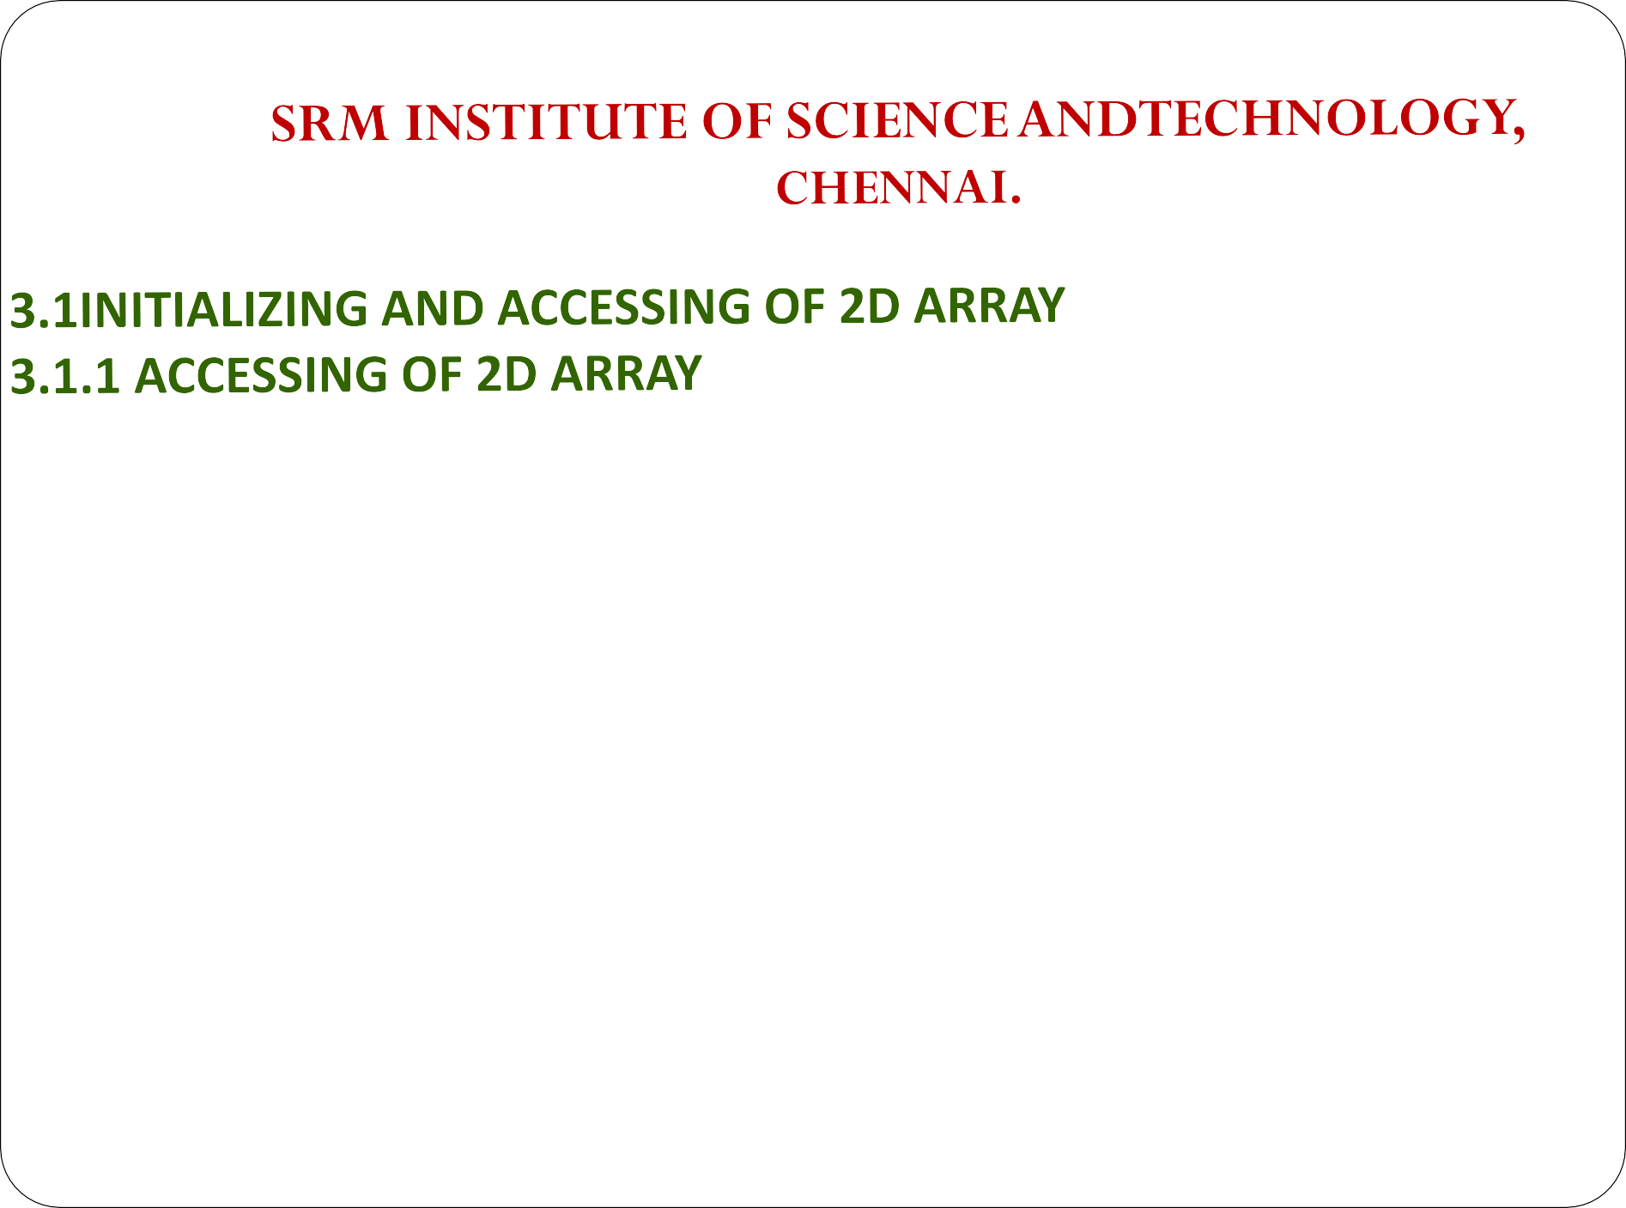

Two Dimensional Array requires Two Subscript Variables
Two Dimensional Array stores the values in the form of matrix.
One Subscript Variable denotes the “Row” of a matrix.
Another Subscript Variable denotes the “Column” of a matrix.
3.1.2 INITIALIZING OF 2D ARRAY
An array of two dimensions can be declared as follows:
data_type array_name[size1][size2];
Here data_type is the name of some type of data, such as int. Also, size1 and size2 are sizes of the array’s first and second dimensions respectively.

Slide 117







Slide 118
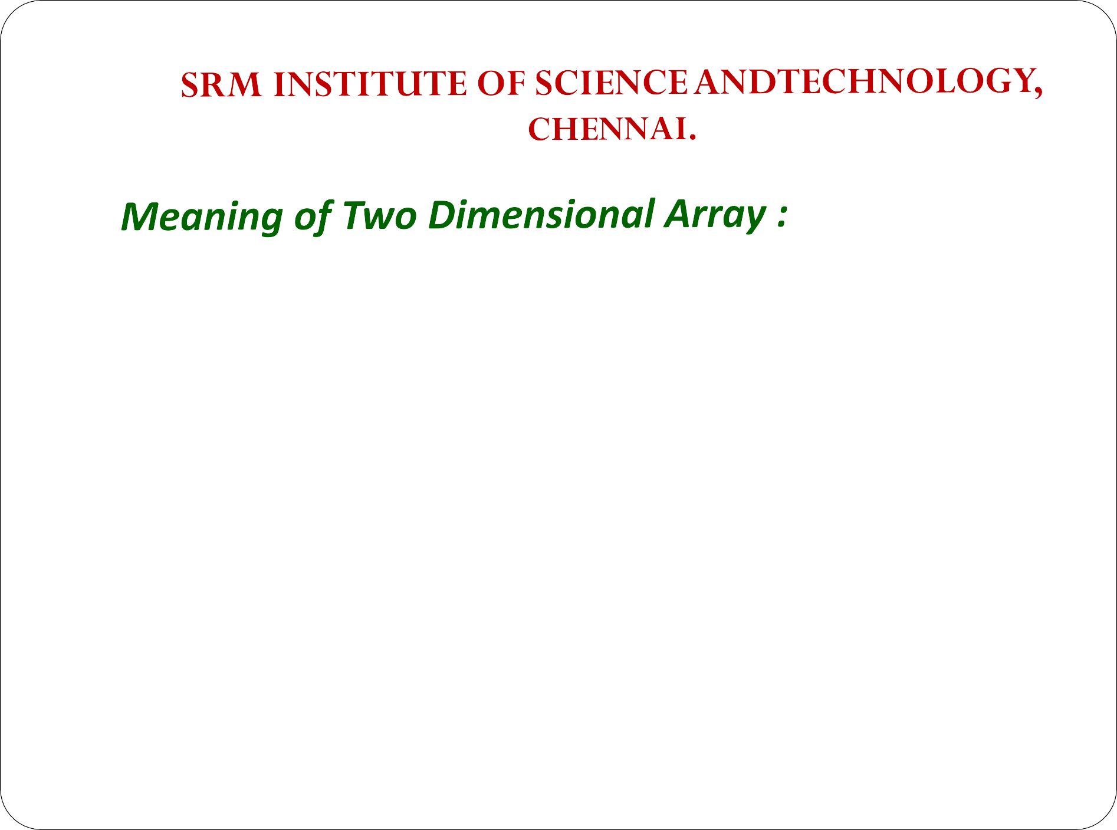






















Slide 119

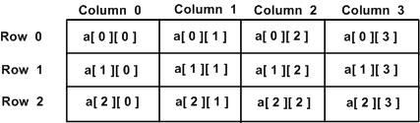

Slide 120
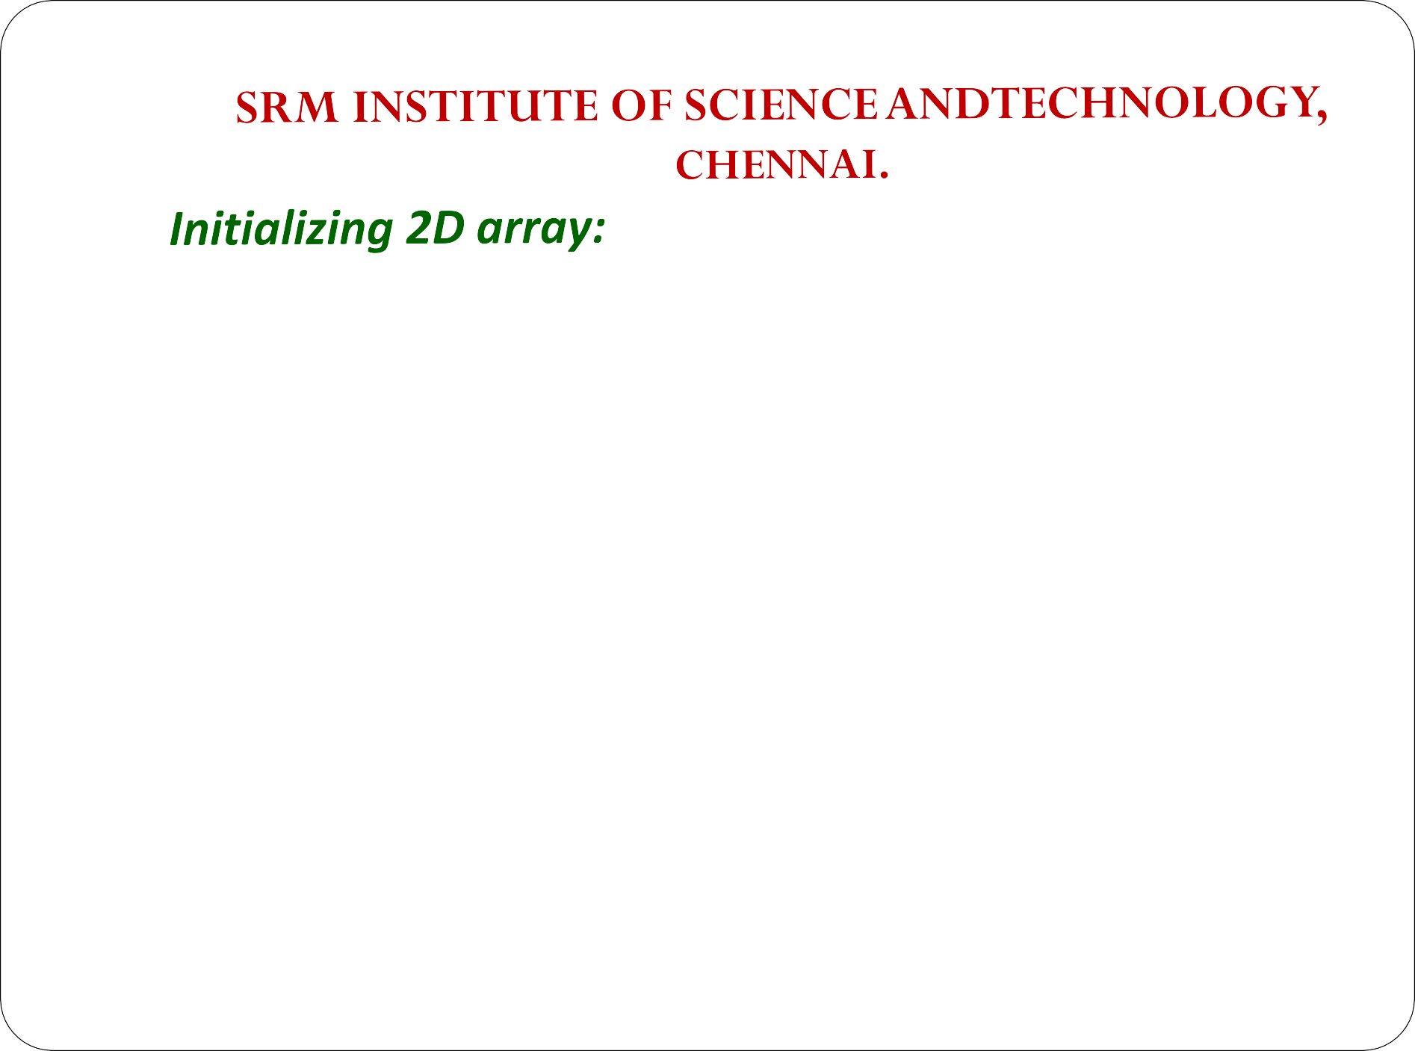








Slide 121
Consider the below program –
#include<stdio.h> int main() {
int i, j;
int a[3][2] = { { 1, 4 },
{ 5, 2 },
{ 6, 5 }};
for (i = 0; i < 3; i++) { for (j = 0; j < 2; j++) {
printf("%d ", a[i][j]);
}
printf("\n");
} return 0;
}
Output :
1 4
5 2
6 5

Slide 122
We have declared an array of size 3 X 2, It contain overall 6 elements. Row 1 : { 1 , 4 },
Row 2 : { 5 , 2 },
Row 3 : { 6 , 5 }
We have initialized each row independently
a[0][0] = 1
A[0][1] = 4

Slide 123
Method 2 : COMBINE ASSIGNMENT
Initialize all Array elements but initialization is much straight forward. All values are assigned sequentially and row-wise
int a[3][2] = {1 , 4 , 5 , 2 , 6 , 5 };
So here it automatically assigns that number 3 has row and number 2 has column.

Slide 124
Output :
1 4
Consider the below program –
#include <stdio.h> int main() {
int i, j;
int a[3][2] = { 1, 4, 5, 2, 6, 5 };
for (i = 0; i < 3; i++) { for (j = 0; j < 2; j++) {
printf("%d ", a[i][j]);
}
printf("\n");
5 2
6 5
} return 0;
}

Slide 125
Method 3: SELECTIVE ASSIGNMENT
int a[3][2] = {
{ 1 },
{ 5 , 2 },
{ 6 }
};
Now we have again going with the way 1 but we are removing some of the elements from the array. In this case we have declared and initialized 2-D array like this

Slide 126
Consider the below program –
Output :
1 0
5 2
6 0
#include <stdio.h> int main() {
int i, j;
int a[3][2] = { { 1 },
{ 5, 2 },
{ 6 }};
for (i = 0; i < 3; i++) { for (j = 0; j < 2; j++) {
printf("%d ", a[i][j]);
} printf("\n"); } return 0;
}

Slide 127
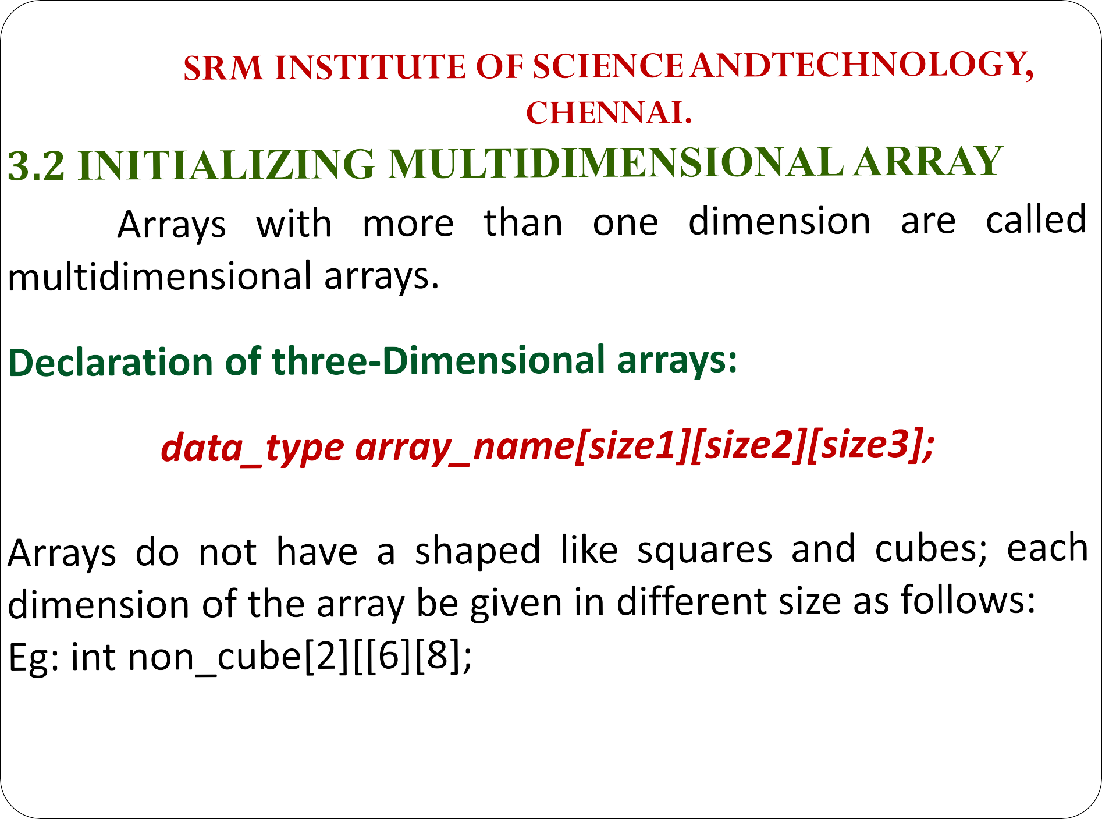

Slide 128

You can initialize a three dimensional array in a similar way like a two dimensional array. Here's an example,
int test[2][3][4] = {
{ {3, 4, 2, 3}, {0, -3, 9, 11}, {9, 1, 6, 2} },
{ {13, 4, 56, 3}, {5, 9, 3, 5}, {3, 1, 4, 9} }
};
In this program we mention size1 – row, size2 – column, size3 –
number of elements in that array.

Slide 129

C Program to store values entered by the user in a three-dimensional array and display it.
#include <stdio.h> int main()
{
int i, j, k, test[2][3][2]; // this array can store 12 elements printf("Enter 12 values: \n");
for(i = 0; i < 2; ++i) { for (j = 0; j < 3; ++j) {
for(k = 0; k < 2; ++k ) { scanf("%d", &test[i][j][k]);
}

Slide 130

}
}
printf("\nDisplaying values:\n");//Displaying values with
proper index.
for(i = 0; i < 2; ++i) {
for (j = 0; j < 3; ++j) { for(k = 0; k < 2; ++k ) {
printf("test[%d][%d][%d] = %d\n", i, j, k, test[i][j][k]);
}
}
}
return 0;
}

Slide 131

OUTPUT:
Enter 12 values:
1
2
3
4
5
6
7
8
9
10
11
12
Displaying Values:
test[0][0][0] = 1
test[0][0][1] = 2
test[0][1][0] = 3
test[0][1][1] = 4
test[0][2][0] = 5
test[0][2][1] = 6
test[1][0][0] = 7
test[1][0][1] = 8
test[1][1][0] = 9
test[1][1][1] = 10
test[1][2][0] = 11
test[1][2][1] = 12

Slide 132

3.3 ARRAY PROGRAMS – 2D
Basic 2d array program
Store and display values
Sum of two matrices using Two dimensional arrays
Transpose of Matrix
Multiplication of 2d matrices.

Slide 133

#include<stdio.h>
int main(){
int disp[2][3]; /* 2D array declaration*/
int i, j; /*Counter variables
for loop*/
for(i=0; i<2; i++) { for(j=0;j<3;j++) {
printf("Enter value for
disp[%d][%d]:", i, j);
scanf("%d", &disp[i][j]);
} }
//Displaying array elements
printf("Two Dimensional array elements:\n");
for(i=0; i<2; i++) { for(j=0;j<3;j++) {
printf("%d ", disp[i][j]); if(j==2){
printf("\n");
}
} }
return 0; }

Slide 134
OUTPUT
Enter value for disp[0][0]:1 Enter value for disp[0][1]:2 Enter value for disp[0][2]:3 Enter value for disp[1][0]:4 Enter value for disp[1][1]:5 Enter value for disp[1][2]:6
Two Dimensional array elements: 1 2 3
4 5 6

Slide 135

#include <stdio.h> const int CITY = 1; const int WEEK = 7; int main()
{
int temperature[CITY][WEEK]; for (int i = 0; i < CITY; ++i) {
for(int j = 0; j < WEEK; ++j) { printf("City %d, Day %d: ",
i+1, j+1);
scanf("%d", &temperature[i][j]);
}
}
printf("\nDisplaying values:
\n\n");
for (int i = 0; i < CITY; ++i) { for(int j = 0; j < WEEK; ++j)
{
printf("City %d, Day %d =
%d\n", i+1, j+1,
temperature[i][j]);
}
}
return 0;
}

Slide 136

OUTPUT
City 1, Day 1: 33
City 1, Day 2: 34
City 1, Day 3: 35
City 1, Day 4: 33
City 1, Day 5: 32
City 1, Day 6: 31
City 1, Day 7: 30
Displaying values: City 1, Day 1 = 33
City 1, Day 2 = 34
City 1, Day 3 = 35
City 1, Day 4 = 33
City 1, Day 5 = 32
City 1, Day 6 = 31
City 1, Day 7 = 30

Slide 137

elements of 2nd
printf("Enter matrix\n");
for(i=0; i<2; ++i)
for(j=0; j<2; ++j)
{
printf("Enter b%d%d: ", i+1, j+1); scanf("%f", &b[i][j]);
}// adding corresponding elements of two arrays
for(i=0; i<2; ++i) for(j=0; j<2; ++j)
{
c[i][j] = a[i][j] + b[i][j];
}
#include <stdio.h> int main()
{
float a[2][2], b[2][2], c[2][2];
int i, j; // Taking input using nested for loop
printf("Enter
matrix\n"); for(i=0; i<2; ++i)
elements of 1st
for(j=0; j<2; ++j)
{
printf("Enter a%d%d: ", i+1, j+1); scanf("%f", &a[i][j]);
} // Taking input using nested for loop

Slide 138
// Displaying the sum printf("\nSum Of Matrix:"); for(i=0; i<2; ++i)
for(j=0; j<2; ++j)
OUTPUT:
Enter elements of 1st matrix
Enter a11: 2;
Enter a12: 0.5;
Enter a21: -1.1;
Enter a22: 2;
Enter elements of 2nd matrix
Enter b11: 0.2;
Enter b12: 0;
Enter b21: 0.23;
Enter b22: 23;
Sum Of Matrix:
{
printf("%.1f\t", c[i][j]); if(j==1)
printf("\n");
}
return 0;
}
2.2 0.5
-0.9 25.0

Slide 139

#include <stdio.h> int main()
{
int a[10][10], transpose[10][10], r, c, i, j;
printf("\nEntered Matrix: \n"); for(i=0; i<r; ++i)
for(j=0; j<c; ++j)
{
printf("%d ", a[i][j]); if (j == c-1)
printf("\n\n");
printf("Enter rows and columns of
matrix: ");
scanf("%d %d", &r, &c); // Storing elements
}// Finding the matrix a
for(i=0; i<r; ++i) for(j=0; j<c; ++j)
{
transpose of
printf("\nEnter
matrix:\n"); for(i=0; i<r; ++i)
for(j=0; j<c; ++j)
{
printf("Enter
",i+1, j+1);
elements of
transpose[j][i] = a[i][j];
}
element
a%d%d:
scanf("%d", &a[i][j]); }

Slide 140
output
// Displaying the transpose of matrix a printf("\nTranspose of Matrix:\n"); for(i=0; i<c; ++i)
for(j=0; j<r; ++j)
{
printf("%d ",transpose[i][j]);
if(j==r-1) printf("\n\n");
}
return 0;
}
Enter rows and columns of matrix: 2 3
Enter element of matrix: Enter element a11: 2 Enter element a12: 3 Enter element a13: 4 Enter element a21: 5 Enter element a22: 6 Enter element a23: 4 Entered Matrix:
2 3 4
5 6 4
Transpose of Matrix: 2 5
3 6
4 4

Slide 141

#include <stdio.h> int main()
{
printf("Enter number of rows and columns of second matrix\n"); scanf("%d%d", &p, &q);
for (c = 0; c < p; c++)
for (d = 0; d < q; d++) scanf("%d", &second[c][d]);
for (c = 0; c < m; c++) { for (d = 0; d < q; d++) { for (k = 0; k < p; k++) {
int m, n, p, q, c, d, k, sum = 0;
int first[10][10], second[10][10], multiply[10][10];
printf("Enter number of rows and columns of first matrix\n"); scanf("%d%d", &m, &n); printf("Enter elements of matrix\n");
for (c = 0; c < m; c++) for (d = 0; d < n; d++)
scanf("%d", &first[c][d]);
sum = sum + first[c][k]*second[k][d];
}
multiply[c][d] = sum; sum = 0;
} }
first

Slide 142

printf("Product of the matrices:\n");
Enter the number of rows and
columns of second matrix:
3
3
for (c = 0; c < m; c++) { for (d = 0; d < q; d++)
printf("%d\t", multiply[c][d]); printf("\n");
} }
return 0;
Enter the matrix:
1 1 2
2 1 1
1 2 1
elements of second
Product of entered matrices:-
}
OUTPUT
Enter the number of rows and columns of first matrix: 3 3
Enter the elements of first matrix: 1 2 0
0 1 1
2 0 1
5 | 3 | 4
3 | 3 | 2
3 | 4 | 5

Slide 143
  ARRAY CONTIGUOUS MEMORY
    When Big Block of memory is reserved or allocated then that memory block is called as Contiguous Memory Block.
    Alternate meaning of Contiguous Memory is continuous memory.
    Suppose inside memory we have reserved 1000-1200 memory addresses for special purposes then we can say that these 200 blocks are going to reserve contiguous memory.

Slide 144
How to allocate contiguous memory:
Using static array declaration.
Using alloc() / malloc() function to allocate big chunk of memory dynamically.
Contiguous Memory Allocation
Two registers are used while implementing the contiguous memory scheme. These registers are base register and limit register.

Slide 145
When OS is executing a process inside the main memory then
content of each register are as –
Register - Content of register.
Base register- Starting address of the
memory
location where process execution is happening.
Limit register- Total amount of memory in bytes consumed by process.
When process try to refer a part of the memory then it will firstly refer the base address from base register and then it will refer relative address of memory location with respect to base address

Slide 146
3.5 ADVANTAGE AND LIMITATIONS OF ARRAY
    Advantages:
      It is better and convenient way of storing the data of same datatype with same size.
      It allows us to store known number of elements in it.
      It allocates memory in contiguous memory locations for its elements. It does not allocate any extra space/ memory for its elements. Hence there is no memory overflow or shortage of memory in arrays.
      Iterating the arrays using their index is faster compared to any other methods like linked list etc.
      It allows to store the elements in any dimensional array - supports multidimensional array.

Slide 147
3.5.2 Limitations of Array:
Static Data
  Array is Static data Structure
  Memory Allocated during Compile time.
  Once Memory is allocated at Compile Time it Cannot be Changed during Run-time.
Can hold data belonging to same Data types
  Elements belonging to different data types cannot be stored in array because array data structure can hold data belonging to same data type.
  Example : Character and Integer values can be stored inside separate array but cannot be stored in single array

Slide 148
Inserting data in Array is Difficult
  Inserting element is very difficult because before inserting element in an array have to create empty space by shifting other elements one position ahead.
  This operation is faster if the array size is smaller, but same operation will be more and more time consuming and non- efficient in case of array with large size.
Deletion Operation is difficult
  Deletion is not easy because the elements are stored in contiguous memory location.
  Like insertion operation , we have to delete element from the array and after deletion empty space will be created and thus we need to fill the space by moving elements up in the array.

Slide 149
Bound Checking
  If we specify the size of array as ‘N’ then we can access elements upto ‘N-1’ but in C if we try to access elements after ‘N-1’ i.e Nth element or N+1th element then we does not get any error message.
  Process of Checking the extreme limit of array is called Bound checking
and C does not perform Bound Checking.
  If the array range exceeds then we will get garbage value as result.
Shortage of Memory
  Array is Static data structure. Memory can be allocated at compile time only Thus if after executing program we need more space for storing additional information then we cannot allocate additional space at run time.
  Shortage of Memory , if we don’t know the size of memory in advance
Wastage of Memory
  Wastage of Memory , if array of large size is defined.

Slide 150

3.6 ARRAY CONSTRUCTION FOR REAL-TIME APPLICATION COMMON PROGRAMMING ERRORS
(i) Constant Expression Require
#include<stdio.h> void main()
{
int i=10; int a[i];
}
In this example we see what’s that error?

Slide 151
We are going to declare an array whose size is equal to the value of variable.
If we changed the value of variable then array size is going to change.
According to array concept, we are allocating memory for array at compile time so if the size of array is going to vary then how it is possible to allocate memory to an array.
i is initialized to 10 and using a[i] does not mean a[10] because ‘i’ is Integer Variable whose value can be changed inside program.

Slide 152
Value of Const Variable Cannot be changed
we know that value of Const Variable cannot be changed once initialized so we can write above example as below –
#include<stdio.h> void main()
{
const int i=10; int a[i];
}
or
int a[10];

Slide 153
(ii) Empty Valued 1D Array
#include<stdio.h> void main()
• | Consider this example, | we
 | can see the empty pair | of
 | square brackets means | we
 | haven’t specified size of | an
{
int arr[];
}
Instead of it Write it as –
#include<stdio.h> void main()
{
int a[] = {1,1};
}
1D Array. In this example
is undefined or
array ‘arr’
empty.
Size of 1D Array should be Specified as a Constant Value.
#include<stdio.h> void main()
{
int a[] = {};// This also
Cause an Error
}

Slide 154
So we Following
have Array
Access to Elements –
(iii) 1D Array with no Bound Checking
#include<stdio.h> void main()
{
int a[5];
printf("%d",a[7]);
}
Here Array size specified is 5.
a[0],a[1],a[2],a[3] and a[4].
But accessing a[5] causes
Garbage Value to be used because C Does not performs Array Bound Check.
If the maximum size of array is “MAX” then we can access following elements of an
array –
Elements accessible for Array Size "MAX" = arr[0]
=.
= arr[MAX-1]

Slide 155
4. Case Sensitive #include<stdio.h> void main()
{
int a[5]; printf("%d",A[2]);
}
Array Variable is Case Sensitive so A[2] does not print anything it Displays Error Message : “Undefined Symbol A“

Slide 156
POINTERS
Definition
A pointer is a variable whose value is the address of another variable, i.e., direct address of the memory location. This is done by using unary operator * that returns the value of the variable located at the address specified by its operand.

Slide 157
POINTERS
Syntax
Datatype *pointervariable;
Syntax Example
1. int *ip; /* pointer to an integer */
double *dp;
float *fp;
char *ch
/* pointer to a double */
/* pointer to a float */
/* pointer to a character */

Slide 158
POINTERS
 Example
int var = 20;
/* actual variable declaration */
int *ip;
/* pointer variable declaration */
ip = &var;
/* store address of var in pointer variable*/

Slide 159
POINTERS
Reference operator (&) and Dereference operator (*)
& is called reference operator. It gives the address of a variable.
* is called dereference operator. It gives the value from the address

Slide 160

Pointer to Pointer
Double (**) is used to denote the double pointer. Double Pointer Stores the address of the Pointer
Variable. Conceptually we can have Triple ….. n pointers.

Slide 161
Example 1
int main()
{
int num = 45 , *ptr , **ptr2ptr ; ptr = &num; //3000
ptr2ptr = &ptr; //4000
printf("%d",**ptr2ptr); return(0);
}
Output 45

Slide 162
Pointer to Constant Objects
These type of pointers are the one which cannot change the value they are pointing to. This means they cannot change the value of the variable whose address they are holding.
const datatype *pointername;
(or) datatype const *pointername;

Slide 163
Example
The pointer variable is declared as a const. We can change address of such pointer so that it will point to new memory location, but pointer to such object cannot be modified (*ptr).

Slide 164
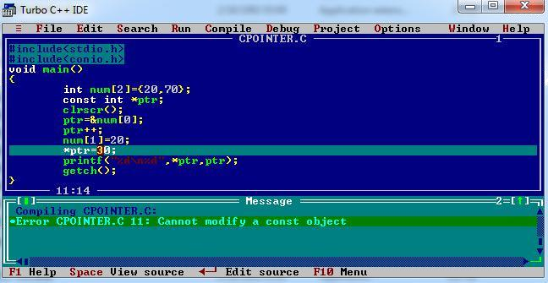
Example

Slide 165
Constant Pointers
Constant pointers are the one which cannot change address they are pointing to. This means that suppose there is a pointer which points to a variable (or stores the address of that variable). If we try to point the pointer to some other variable, then it is not possible.
int* const ptr=&variable; (or)
int *const ptr=&variable // ptr is a constant pointer to int

Slide 166
Null pointer
NULL Pointer is a pointer which is pointing to nothing.
Pointer which is initialized with NULL value is considered as NULL pointer.
datatype *pointer_variable=0; datatype *pointer_variable=NULL;

Slide 167
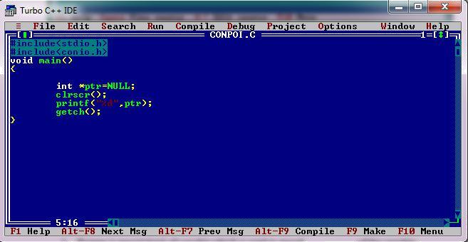
Example

Slide 168
Pointer Arithmetic
C allows you to perform some arithmetic operations on pointers.
Incrementing a pointer
Incrementing a pointer is one which increases the number of bytes of its data type.
int *ptr;
int a[]={1,2,3};
ptr=&a;
ptr++;
ptr=&a;
ptr=ptr+1;

Slide 169
Pointer Arithmetic
 Decrementing a Pointer
Decrementing a pointer is one which decreases the number of bytes of its data type.
Using Unary Operator
int *ptr;
int a[]={1,2,3};
ptr=&a;
ptr--;

Slide 170
Limitations of Pointer Arithmetic
Addition of 2 pointers is not allowed
Addition of a pointer and an integer is commutative ptr+5ó 5+ptr
Subtraction of 2 pointers is applicable.
subtraction of a pointer and an integer is not commutative ptr-5≠ 5-ptr.
Only integers can be added to pointer. It is not valid to add a float or double value to a pointer.
A pointer variable cannot be assigned a non address value except zero.
Multiplication and division Operators cannot be applied on pointers.
Bitwise operators cannot be applied on pointers.
A pointer and an integer can be subtracted.
A pointer and an integer can be added.

Slide 171
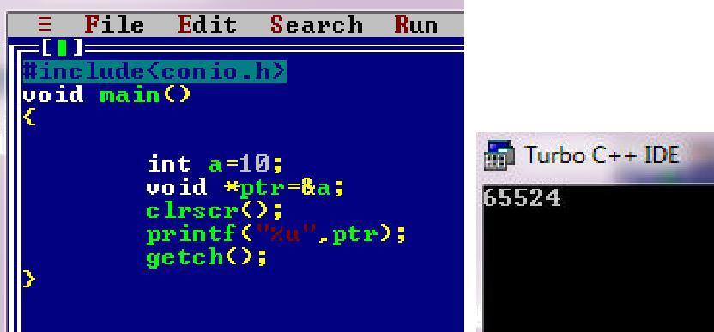
Void pointer
1.Void pointer is a generic pointer and can point to any type of object.The type of object can be char, int, float or any other type.
 Example

Slide 172
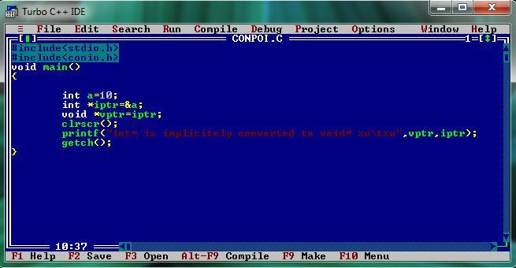
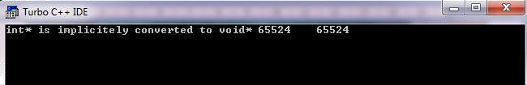
2.A pointer to any type of object can be assigned to a void pointer.
OUTPUT

Slide 173
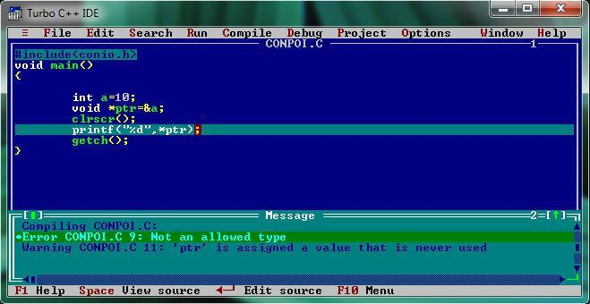
3. A void pointer cannot be dereferenced

Slide 174
Relational operations
A pointer can be compared with a pointer of same type or zero.
Various relational operators are ==.,!=,<,<=,>,>=
Ex: float a=1.0,b=2.0,*fptr1,*fptr2;
fptr1=&a;fptr2=&b;
int result;
result=fptr1!=fptr2;

Slide 175
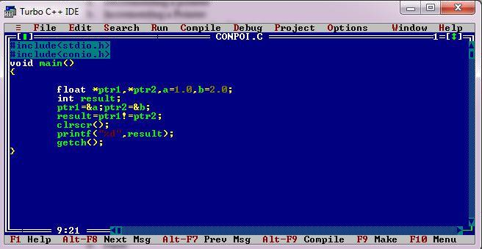
Example

Slide 176
Pointers and Arrays
Pointers and arrays are closely related , An array variable is actually just a pointer to the first element in the array.
Accessing array elements using pointers is efficient way than using array notation.
When an array is declared, compiler allocates sufficient amount of memory to contain all the elements of the array.
Base address i.e address of the first element of the array is also allocated by the compiler.

Slide 177
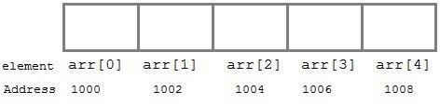
Pointers and Arrays Cont…
Suppose we declare an array arr,
int arr[5]={ 1, 2, 3, 4, 5 };Assuming that the base address of arr is 1000 and each integer requires two bytes, the five elements will be stored as follows

Slide 178
Pointers and Arrays Cont…
Here variable arr will give the base address, which is a constant pointer pointing to the element, arr[0].
Therefore arr is containing the address of arr[0] i.e 1000. In short, arr has two purpose- it is the name of an array and it acts as a pointer pointing towards the first element in the array.

Slide 179
Pointers and Arrays Cont…
int *p; p = arr; or
p = &arr[0];
Now we can access every element of array arr using p++ to move from one element to another.

Slide 180
Pointers and Arrays Cont…
a[0] is the same as *a
a[1] is the same as *(a + 1)
a[2] is the same as *(a + 2)
If pa points to a particular element of an array, (pa + 1) always points to the next element, (pa + i) points i elements after pa and (pa - i) points i elements before.

Slide 181
Example 1
#include<stdio.h> void main()
{
int a[10],i,n; printf("Enter n"); scanf("%d",&n);
for(i=0;i<n;i++) scanf("%d",&a[i]); for(i=0;i<n;i++) printf("a[%d]=%d\n",i,*(a+i));
}

Slide 182
Output
Enter n 5
1 2 3 4 5 a[0]=1
a[1]=2
a[2]=3
a[3]=4
a[4]=5

Slide 183
Pointer to Multidimensional Array
A multidimensional array is of form, a[i][j]. Lets see how we can make a pointer point to such an array.
As we know now, name of the array gives its base address. In a[i][j], a will give the base address of this array, even a+0+0 will also give the base address, that is the address of a[0][0] element.
Here is the generalized form for using pointer with multidimensional arrays.
*(*(a + i) + j) is same as a[i][j].

Slide 184
Example 2
#include <stdio.h> #define ROWS 4
#define COLS 3 int main ()
{
int i,j;
// declare 4x3 array
int matrix[ROWS][COLS] = {{1, 2, 3},
{4, 5, 6},
{7, 8, 9},
{10, 11, 12}};
for (i = 0; i < ROWS; i++)
{
for (j = 0; j < COLS; j++)
{
printf("%d\t", matrix[i][j]);
}
printf("\n");
}
return 0;
}

Slide 185
Output
1 | 2 | 3
4 | 5 | 6
7 | 8 | 9
10 | 11 |  | 12

Slide 186
matrix[0][0] = *(*(matrix))
matrix[i][j] = *((*(matrix)) + (i * COLS + j)) matrix[i][j] = *(*(matrix + i) + j)
matrix[i][j] = *(matrix[i] + j) matrix[i][j] = (*(matrix + i))[j]
&matrix[i][j] = ((*(matrix)) + (i * COLS + j))

Slide 187
Example 3
void array_of_arrays_ver(int arr[][COLS])
{
int i, j;
for (i = 0; i < ROWS; i++)
{
for (j = 0; j < COLS; j++)
{
printf("%d\t", arr[i][j]);
}
printf("\n");
}
}
void ptr_to_array_ver(int (*arr)[COLS])
{
int i, j;
for (i = 0; i < ROWS; i++)
{
for (j = 0; j < COLS; j++)
{
printf("%d\t", (*arr)[j]);
}
arr++; printf("\n");
}
}

Slide 188
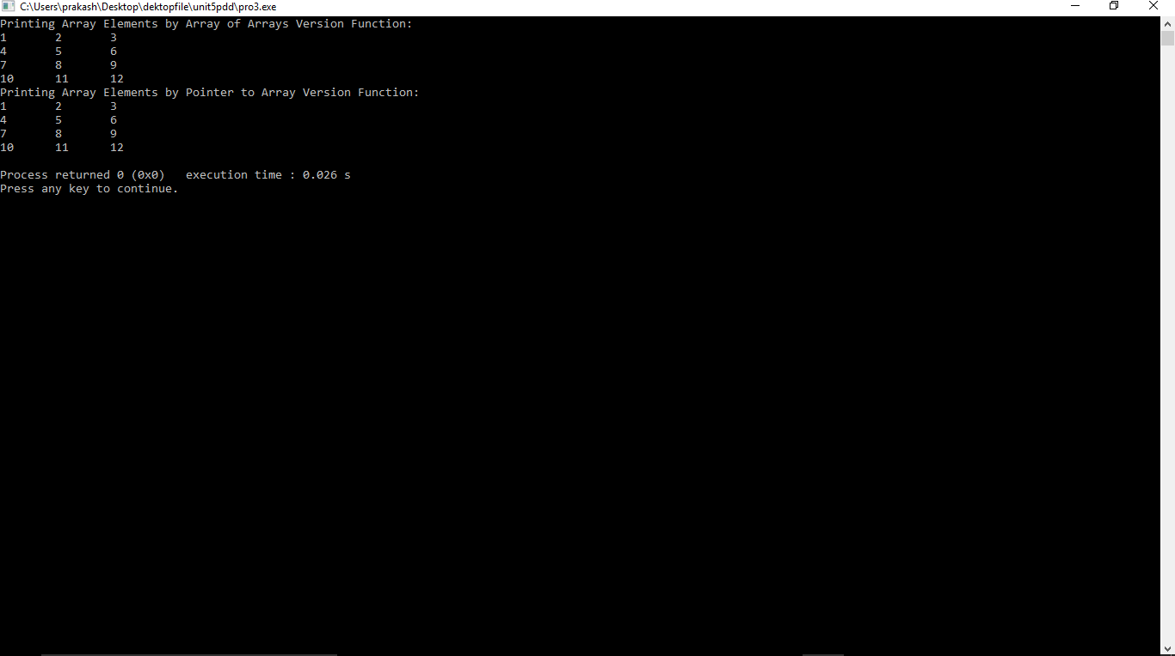
Output

Slide 189
Double Pointer
#include <stdio.h> #define ROWS 4
#define COLS 3
int main ()
{
// matrix of 4 rows and 3 columns
int matrix[ROWS][COLS] = {{1, 2, 3},
{4, 5, 6},
{7, 8, 9},
{10, 11, 12}};
int** pmat = (int **)matrix;
printf("&matrix[0][0] = %u\n", &matrix[0][0]);
printf("&pmat[0][0] = %u\n", &pmat[0][0]); return 0;
}

Slide 190
Output
&matrix[0][0] = 2675498000
&pmat[0][0] = 1

Slide 191
Passing an array to a function
Single element of an array can be passed in similar manner as passing variable to a function
C program to pass a single element of an array to
function
#include <stdio.h> void display(int age)
{
printf("%d", age);
}
int main()
{
int ageArray[] = { 2, 3, 4 };
display(ageArray[2]); //Passing array element ageArray[2] only.
return 0;
}
OUTPUT
4

Slide 192
Passing an entire one-dimensional array to a function
#include<stdio.h>
int total(int[],int);
void main()
{
int a[10],n,sum,i; printf("Enter n\n"); scanf("%d",&n); for(i=0;i<n;i++)
scanf("%d",&a[i]); sum=total(a,n); printf("Sum=%d",sum);
}
int total(int a[],int n)
{
int sum=0,i;
for(i=0;i<n;i++)
sum=sum+a[i]; return sum;
}

Slide 193
Output
Enter n
5
1
2
3
4
5
Sum=15

Slide 194
Passing Multi-dimensional Arrays to Function
To pass two-dimensional array to a function as an argument, starting address of memory area reserved is passed as in one dimensional array

Slide 195
Example 4
void displayNumbers(int num[2][2])
{
// Instead of the above line,
// void displayNumbers(int num[][2]) is also valid
int i, j; printf("Displaying:\n"); for (i = 0; i < 2; ++i)
for (j = 0; j < 2; ++j) printf("%d\n", num[i][j]);
}
#include <stdio.h>
void displayNumbers(int num[2][2]); int main()
{
int num[2][2], i, j; printf("Enter 4 numbers:\n"); for (i = 0; i < 2; ++i)
for (j = 0; j < 2; ++j)
scanf("%d", &num[i][j]);
// passing multi-dimensional array to displayNumbers function
displayNumbers(num); return 0;
}

Slide 196
Output
Enter 4 numbers:
1
2
3
4
Displaying: 1
2
3
4

Slide 197
Pointers and Strings
Strings as arrays:In C, the abstract idea of a string is implemented with just an array of characters. For example, here is a string:
char label[] = "Single";What this array looks like in memory is the following:
S | i | n | g | l | e | \0

Slide 198
Pointers and Strings cont...
where the beginning of the array is at some location in computer memory, for example, location 1000.
A character array can have more characters than the
abstract string held in it, as below:
char label[10] = "Single"; giving an array that looks like:
S i n g l e \0
we can access each character in the array using subscript notation, as in:
printf("Third char is: %c\n", label[2]);
which prints out the third character, n.

Slide 199
Disadvantage Of Creating Strings Using The Character Array
A disadvantage of creating strings using the character array syntax is that you must say ahead of time how many characters the array may hold. For example, in the following array definitions, we state the number of characters (either implicitly or explicitly) to be allocated for the array.
char label[] = "Single"; /* 7 characters */ char label[10] = "Single";
Thus, you must specify the maximum number of characters you will ever need to store in an array.
This type of array allocation, where the size of the array is determined at compile-time, is called static allocation.

Slide 200
String as Pointers
Another way of accessing a contiguous chunk of memory, instead of with an array, is with a pointer.
However, pointers only hold an address, they cannot hold all the characters in a character array.
This means that when we use a char * to keep track of a string, the character array containing the string must already exist (having been either statically- or dynamically-allocated).
char label[] = "Single";
char label2[10] = "Married"; char *labelPtr;
labelPtr = label;

Slide 201
Example1
#include <stdio.h> int main()
{
char *sample = "From whence cometh my help?n"; while(putchar(*sample++))
;
return(0);
}
Output:
From whence cometh my help?n

Slide 202
Passing Strings
Below is the definition of a function that prints a label and a call to that function:
void PrintLabel(char the_label[])
{
printf("Label: %s\n", the_label);
}
...
int main(void)
{
char label[] = "Single";
...
PrintLabel(label);
...
}

Slide 203
Passing Strings Cont...
Since label is a character array, and the function PrintLabel() expects a character array, the above makes sense.
However, if we have a pointer to the character array label, as in:
char *labelPtr = label;
then we can also pass the pointer to the function, as in:
PrintLabel(labelPtr);

Slide 204
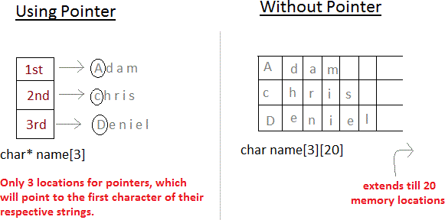
Array of Pointers
 Pointers are very helpful in handling character array with rows of varying length.
char *name[3]={ "Adam", "chris", "Deniel" }; //Now see same array without using pointer char name[3][20]= { "Adam", "chris", "Deniel" };

Slide 205
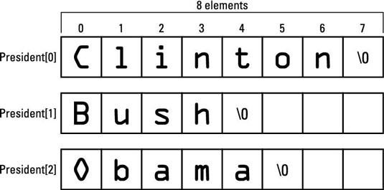
Example1
#include <stdio.h> #define SIZE 3
int main()
{
char president[SIZE][8] = { "Clinton",
"Bush", "Obama"
};
int x,index; for(x=0;x<SIZE;x++)
{
index = 0; while(president[x][index] != '\0')
{
putchar(president[x][index]);
index++;
}
putchar('n');
}
return(0);
}
Output:
ClintonnBushnObaman

Slide 206
THANK YOU

